Slide 1


EEG P300 TRUTH ELICITOR
the ohio rizzlers
Steven Veld, Darren Vawter, Sandra Karon, Ben Falkenburg, Mateo Umaguing, Davis Sandberg
University of California, Los Angeles

Slide 2

MOTIVATION

Slide 3

PREVIOUS WORK

Slide 4
PROBE, TARGET, IRRELEVANT (PTI) PARADIGM

Slide 5



PREVIOUS WORK
PROBE, TARGET, IRRELEVANT (PTI) PARADIGM
probe
(criminal accomplice)
target
irrelevant
(others)

Slide 6
PREVIOUS WORK
PROBE, TARGET, IRRELEVANT (PTI) PARADIGM

Slide 7
PREVIOUS WORK
PROBE, TARGET, IRRELEVANT (PTI) PARADIGM
accomplice-target correlation

Slide 8
PREVIOUS WORK
PROBE, TARGET, IRRELEVANT (PTI) PARADIGM
suspect-target correlation

Slide 9
PTI VALIDATION
for each suspect:
compare P300 signal to target P300 signal

Slide 10
PTI CORRELATION PSEUDOCODE
for each suspect {
dataS = suspect-labeled trials
dataA = accomplice-labeled trials
dataO = other-labeled trials
bootstrapIndex = 0
for i in n_iterations {
suspectMeanSignal = take mean of n_samples of trials from dataS
accompliceMeanSignal = take mean of n_samples of trials from dataA
otherMeanSignal = take mean of n_samples of trials from dataO
SAC = double-centered correlation between suspectMeanSignal and accompliceMeanSignal
SOC = double-centered correlation between suspectMeanSignal and otherMeanSignal
if SAC > SOC
bootstrapIndex++
}
}
guess is the subject with highest bootstrapIndex

Slide 11
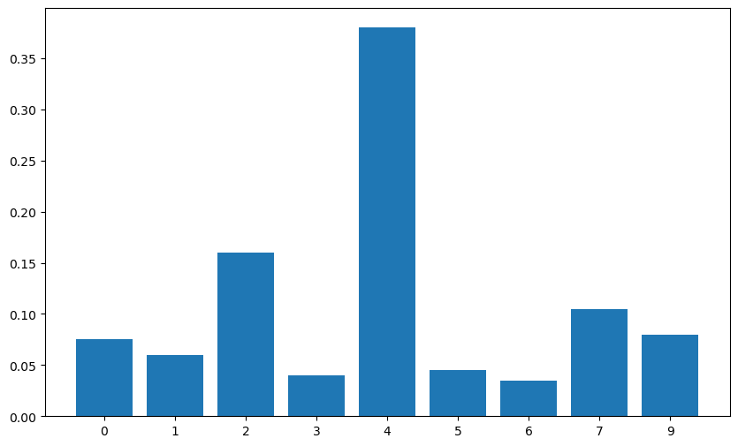
PTI VALIDATION

Slide 12
PTI VALIDATION

Slide 13

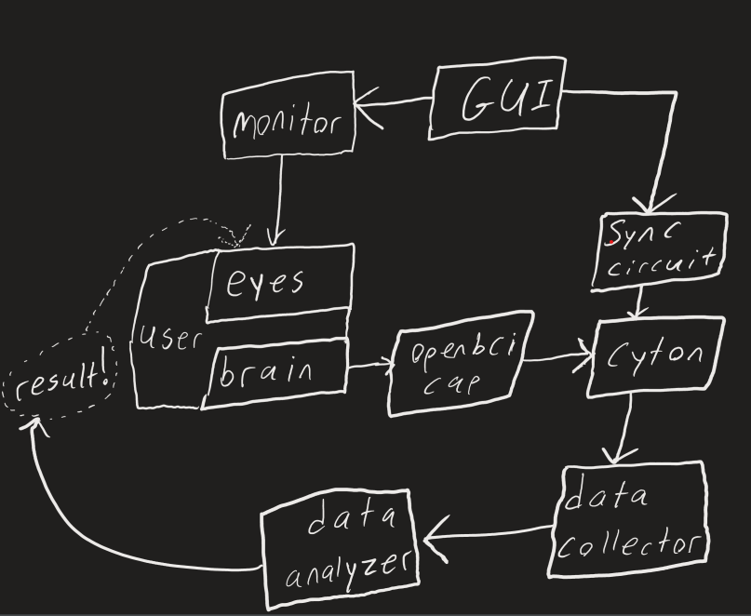

Slide 22
OUR APPROACH

Slide 23
OUR APPROACH

Slide 24
OUR APPROACH

Slide 25
PARADIGM

Slide 26
PARADIGM

